Slide 1







1
Jakob’s Heuristic
Visibility of
System Status
Definition The design should always keep users informed about what is going on, through appropriate feedback within a reasonable amount of time.
1
1
Knowing what the current system status is can help users learn the outcome of their prior interactions and determine next steps.
•
Tip: Communicate clearly to users what the system’s state is — no action with consequences to users should be taken without informing them.
Tip: Present feedback to the user as quickly as possible.
Tip: Build trust through open and continuous communication.
“You Are Here” maps
Interactive mall maps have to show people where they currently are, to help them understand where to go next.
Checkout flow
Multistep processes show users which steps they’ve completed, they’re currently working on, and what comes next.
Phone tap
Touchscreen UIs need to reassure users that their taps have an effect — o en through visual change or haptic feedback.
Predictible interactions create trust in the product as well as the brand.
•
•
2
Info Shipping Payment Review
3
$43.23
Pay now
www.nngroup.com/articles/visibility-system-status/

Slide 2




2
Jakob’s Heuristic
Match between System
and the Real World
Definition The design should speak the users' language. Use words, phrases, and concepts familiar to the user, rather than internal jargon. Follow real-world conventions, making information appear in a natural and logical order.
1
The language you should use depends very much on your specific users.
•
Tip: Ensure users can understand meaning without having to go look up a word’s definition.
Tip: Never assume your understanding of words or concepts will match those of your users.
Tip: User research will help you uncover your users' familiar terminology, as well as their mental models around important concepts.
¹ Stovetop controls
When stovetop controls match the layout of heating elements, users can quickly understand which control maps to each heating element.
² “Car” vs. “automobile”
If users think about this object as a “car,” use that as the label instead.
³3 Shopping cart icon
A shopping cart icon is easily recognizable because that feature serves the same purpose as its real-life counterpart.
•
•
3
2
Car
₂ Automobile
Shopping Cart
Check Out
www.nngroup.com/articles/match-system-real-world/

Slide 3






3
Jakob’s Heuristic
User Control
and Freedom
Definition Users often perform actions by mistake. They need a clearly marked "emergency exit" to leave the unwanted action without having to go through an extended process.
1
When it's easy for people to back out of a process or undo an action, it fosters a sense of freedom and confidence.
•
Tip: Support Undo
and Redo.
Tip: Show a clear way to exit the current interaction, like a "Cancel" button.
Tip: Make sure the exit is clearly labeled and discoverable.
1 Exit sign
Digital spaces need quick “emergency” exits, just like physical spaces do.
•
Undo and redo
These functions give users freedom because they don’t have worry about their actions — everything is easily reversible.
Cancel button
Users shouldn’t have to commit to a process once it’s started — they should be able to easily cancel and abandon.
Exits allow users to remain in control of the system and avoid getting stuck and feeling frustrated.
•
2
Untitled document
3
Undo Redo
Delete Photo
Cancel
www.nngroup.com/articles/user-control-and-freedom

Slide 4




4
Jakob’s Heuristic
Consistency
and Standards
Definition Users should not have to wonder whether different words, situations, or actions mean the same thing. Follow platform and industry conventions.
1
 | CHECK IN
Jakob's Law states that people spend most of their time on products other than yours. Failing to maintain consistency may increase the users' cognitive load by forcing them to learn something new.
•
Tip: Improve learnability by maintaining both types of consistency: internal and external.
Tip: Maintain consistency within a single product or a family of products (internal consistency).
Tip: Follow established industry conventions (external consistency).
Check-in counter
Check-in counters are usually located at the front of hotels. This consistency meets customers’ expectations.
Design system
Using elements from the same design system across the product lines lowers the learning curve of users.
Noti cations
A standardized notification design provides a similar but distinguishable look and feel for different app pop-ups.
•
•
Colors
2
#F0557B
#4F2330
#FFFFFF
3
12:34
#D51D50
#35151D
Typography
Aa
Light
Aa
Reg
Aa
Med
Aa
Bold
Components
Button
Button
Button
Button
www.nngroup.com/articles/consistency-and-standards/

Slide 5







₅ Error Prevention
Jakob’s Heuristic
Definition Good error messages are important, but the best designs carefully prevent problems from occuring in the first place. Either
eliminate error-prone conditions, or check for them and present users with a confirmation option before they commit to the action.
1
There are two types of errors: slips and mistakes.
Slips are unconscious errors caused by inattention.
Mistakes are conscious errors based on a mismatch between the user’s mental model and the design.
•
Tip: Prioritize your effort: Prevent high-cost errors first, then little frustrations.
Tip: Avoid slips by providing helpful constraints and good defaults.
Tip: Prevent mistakes by removing memory burdens, supporting undo, and warning your users.
¹ Guard rails
Guard rails on curvy mountain roads prevent drivers from falling off of cliffs.
•
Airline con rmation
The confirmation page before checking out on airline websites gives users another chance to review the flight details.
Date selection on calendar
Offer good defaults and set boundaries when people book services by dates.
Grey out unavailable options.
•
2
Review Flights and Pay
Confirm Booking
3
Nov 17 – Nov 26
7
17 18 19 20 21 22
23 24 25 26
www.nngroup.com/articles/slips/

Slide 6










6
Jakob’s Heuristic
Recognition Rather Than Recall
Definition Minimize the user's memory load by making elements, actions, and options visible. The user should not have to remember information from one part of the interface to another. Information required to use the design should be visible or easily retrievable when needed.
1
Humans have limited short-term memories. Interfaces that promote recognition reduce the amount of cognitive effort required from users.
•
Tip: Let people recognize information in the interface, rather than having to remember (“recall”) it.
Tip: Offer help in-context, instead of giving users a long tutorial to memorize.
Tip: Reduce the information that users have to remember.
Lisbon
People are more likely to correctly answer the question “Is Lisbon the capital of Portugal?” rather than “What’s the capital of Portugal?”
Comparison table
Comparison tables list key differences so that users don’t need to remember them to make comparisons.
Search
Search queries are presented together with the results as a reference.
•
•
2
iPad Pro 12.9-in. (4th gen)
iPad Air (3rd gen)
iPad (7th gen)
3
The Lion King
Search results
www.nngroup.com/articles/recognition-and-recall/

Slide 7






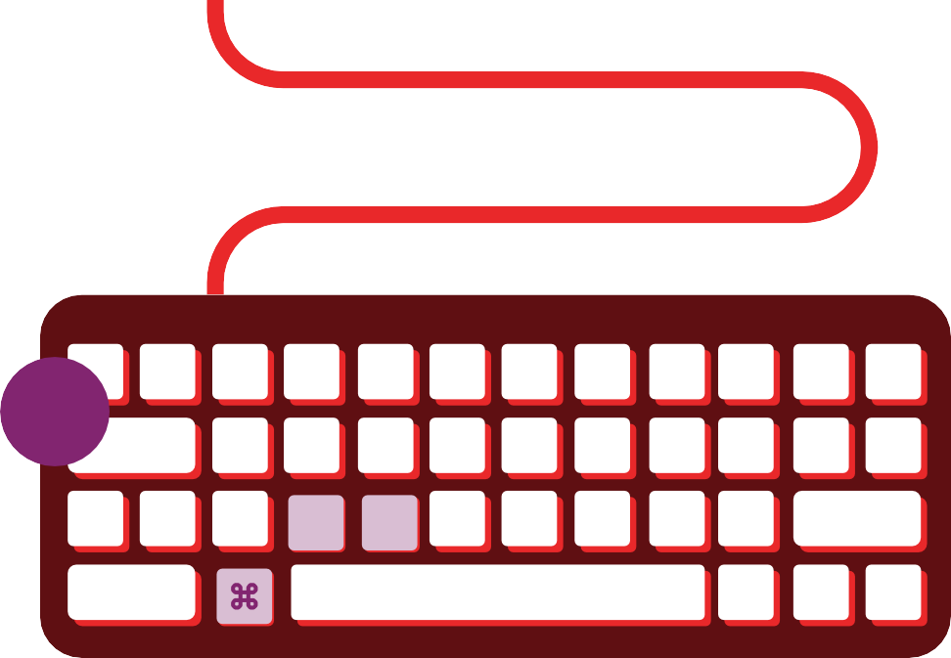




7
Jakob’s Heuristic
Flexibility and
Efficiency of Use
Definition Shortcuts — hidden from novice users — may speed up the interaction for the expert user such that the design can cater to both inexperienced and experienced users. Allow users to tailor frequent actions.
1
Flexible processes can be carried out in different ways, so that people can pick whichever method works for them.
•
Tip: Provide accelerators like keyboard shortcuts and touch gestures.
Tip: Provide personalization by tailoring content and functionality for individual users.
Tip: Allow for customization, so users can make selections about how they want the product to work.
Shortcuts
Regular routes are listed on maps, but locals with more knowledge of the area can take shortcuts.
Keyboard shortcut
Keyboard shortcuts for complex products can help expert users finish their tasks more e ciently.
Tap to like
Social apps allow two ways to like posts. Experienced users can tap to like because it speeds up their browsing.
•
•
3
2
C V
www.nngroup.com/articles/flexibility-efficiency-heuristic

Slide 8





8
Jakob’s Heuristic
Aesthetic and
Minimalist Design
Definition Interfaces should not contain information which is irrelevant or rarely needed. Every extra unit of information in an interface competes with the relevant units of information and diminishes their relative visibility.
1
This doesn't mean you have to use a flat design — it's about making sure you're keeping the content and visual design focused on the essentials. Ensure that the visual elements of the UI support the user's primary goals.
•
Tip: Keep the content and visual design of UI focus on the essentials.
Tip: Don't let unnecessary elements distract users from the information they really need.
Tip: Prioritize the content and features to support primary goals.
¹ Ornate vs. simple teapot Excessive decorative elements can interfere with usability.
•
Communicate, don’t decorate
Over-decoration can cause distraction and make it harder for people to get the core information they need.
Messy vs organized UI
Messy UI increases the interaction cost for users to find their desired content; Organized UI lowers the cost.
•
2
3
3
COMMUNICATE,
DOn't deco ate
One of our favorite slogans
www.nngroup.com/articles/aesthetic-and-minimalist-design/

Slide 9





9
Jakob’s Heuristic
Help Users Recognize, Diagnose, and Recover from Errors
Definition Error messages should be expressed in plain language (no error codes), precisely indicate the problem, and constructively suggest a solution.
WRONG WAY
1
Error messages should be presented with visual treatments that will help users notice and recognize them.
•
Tip: Use traditional error message visuals, like bold, red text.
Tip: Tell users what went wrong in language they will understand — avoid technical jargon.
Tip: Offer users a solution, like a shortcut that can solve the error immediately.
¹ Wrong way sign
Wrong-way signs on the road remind drivers that they are heading in the wrong direction and ask them to stop.
² Internet connection error
Good internet connection error pages show what happened and constructively instruct users on how to fix the problem.
³ No search results
Provide useful help when people encounter search-result pages returning zero results, such as popular topics.
•
•
2
3
No results for “Teddy bear”
There is no Internet connection
Try:
You might try
www.nngroup.com/articles/error-message-guidelines/

Slide 10







10
Jakob’s Heuristic
Help and
Documentation
Definition It’s best if the design doesn’t need any additional explanation. However, it may be necessary to provide documentation to help users understand how to complete their tasks.
i
1
Help and documentation content should be easy to search and focused on the user's task. Keep it concise, and list concrete steps that need to be carried out.
•
Tip: Ensure that the help documentation is easy to search.
Tip: Whenever possible, present the documentation in-context right at the moment that the user requires it.
Tip: List concrete steps to be carried out.
¹ Airport information center
Information kiosks at airports are easily recognizable and solve customers' problems in context and immediately.
Frequently asked questions
Good frequently-asked-question pages anticipate and provide the helpful information that users might need.
Information icon
Information icons reveal tooltips to explain jargon when users touch or hover over them, which provides contextual help.
•
•
2
3
Frequently Asked Questions
www.nngroup.com/articles/help-and-documentation/

Slide 11
Resources:

